Slide 2

Cro-Fu
FusionFabric CrowdFunding Platform
Paris Hackathon ‘15

Slide 3

What is CrowdFunding?
Funding of Projects by Individuals
CFPs are Online Lending Exchanges
Many Types of Funded Projects
Donation (Charity, …)
Reward based
Equity based
Debt based (CrowdLending, P2PL)
And … Mortgage

Slide 4

CrowdFunding Market
>1 Million Projects
>1300 Existing Platforms
$34bn in yearly transactions
Banks Scratching the Surface
$1tn target in 2020
1,000,000,000,000
Notes:
Source crowdsourcing.org
http://www.crowdsourcing.org/editorial/global-crowdfunding-market-to-reach-344b-in-2015-predicts-massolutions-2015cf-industry-report/45376
To put this in perspective, Entire US Residential Mortgage is 11tn
Source http://www.federalreserve.gov/econresdata/releases/mortoutstand/current.htm

Slide 5

Why Misys and Fusion Crowdfunding?
Technology
Resilience, Scalability, SaaS ready, SOA
Client Base
Financial Institutions
Functional Expertise
Existing Lending Business
Extend the concept with Interconnections
Culture
Customer Success Is Central to all we do
High Performance Culture …
Outstanding Financial Performance
Notes:
Technology: Our technology is perfect for what is needed here
Client Base: We are already talking to
Functional Expertise: We have solid credibility in lending with CCS in Dallas (Acquired 2014) and Loan IQ in NY
Culture:
Customer Success is central to all we do : we want banks to get a slice of the crowdfunding pie
High Performance Culture and great place to work : Challenge to build 24/7 solutions for 100k+ users
Outstanding financial performance : This is a juicy greenfield market for us, meaning loads of upsell.

Slide 6

Hackathon Challenges
Integration with Banks Systems
Website & Rest Services,
Scalability
Global Retail Base ⇨ 24/7
Multi node FF
Artificial Intelligence
Projects Cherry Picking
Notes:
The system needs to be designed for a large user base
Web Site
Payments (>41 APIs)
Single Sign On
Escrow Accounts

Slide 7
Demo

Slide 8
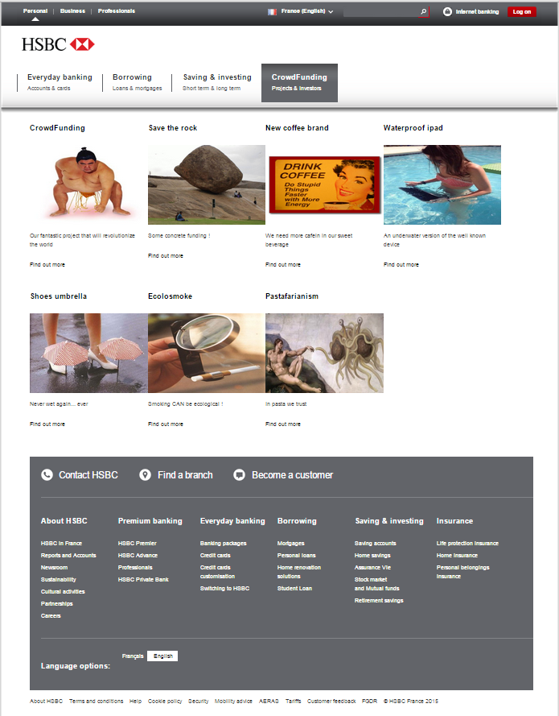

Websites Integration

Slide 9

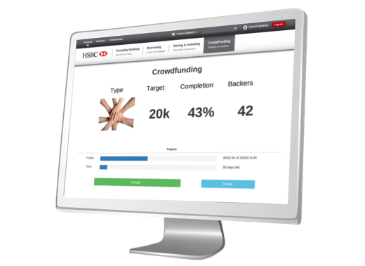

Demo Architecture
Notes:
Load balancers + two cargo nodes

Slide 10
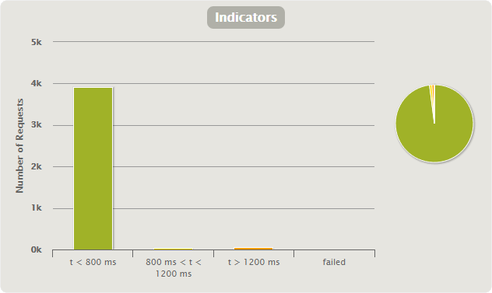
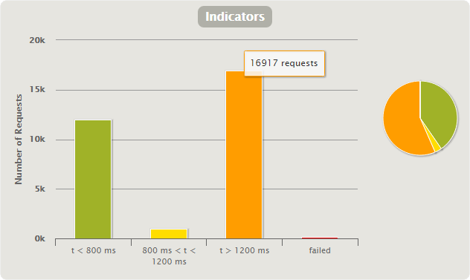
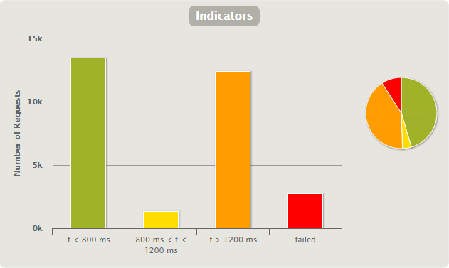
Scalability
1k users / 1 node : 98-1-1-0
10k users / 1 node : 45-4-41-9
10k users / 2 nodes : 40-4-56-0

Slide 11
Artificial Intelligence

Slide 12
Conclusion

Slide 13
Takeaways
Market is Ripe for this Solution
Misys is the Perfect Provider

Slide 14


Still not convinced?
I am positive this is great concept
This ought to be turned into an actual product
Notes:
If all of the above has not convinced you, we have marketing fallback
Reveal Kate
That is targeting all audiences
=> Reveal dude

Slide 15

Vote for us!

Slide 16
Frederic Andre, Marie-Lise Hamel, Jean-Cedric Jollant, Laurent Lhermine Consultants: Romain Gilles, Yoan Maman, Humberto Pereira

